Slide 1

LANGUAGE TRANSLATOR
Patel Aniket 17ITUON021
Patel Abhishek 17ITUOS126

Slide 2
Description
Our Language is basically used for calculating the relative humidity of the Atmosphere. It is an important aspect in industries as it may effect the efficiency and production of the industries. To low relative humidity may dry up products and to high relative humidity may increase the "water activity" and the growing of mold and bacteria in process lines and their products. There are certain Recommended Relative Humidity (%) for different industries .
Here the user have to enter the temperature of dry and wet thermometer bulb form the Psychrometer.
User can also convert from Celsius or kelvin to Fahrenheit

Slide 3
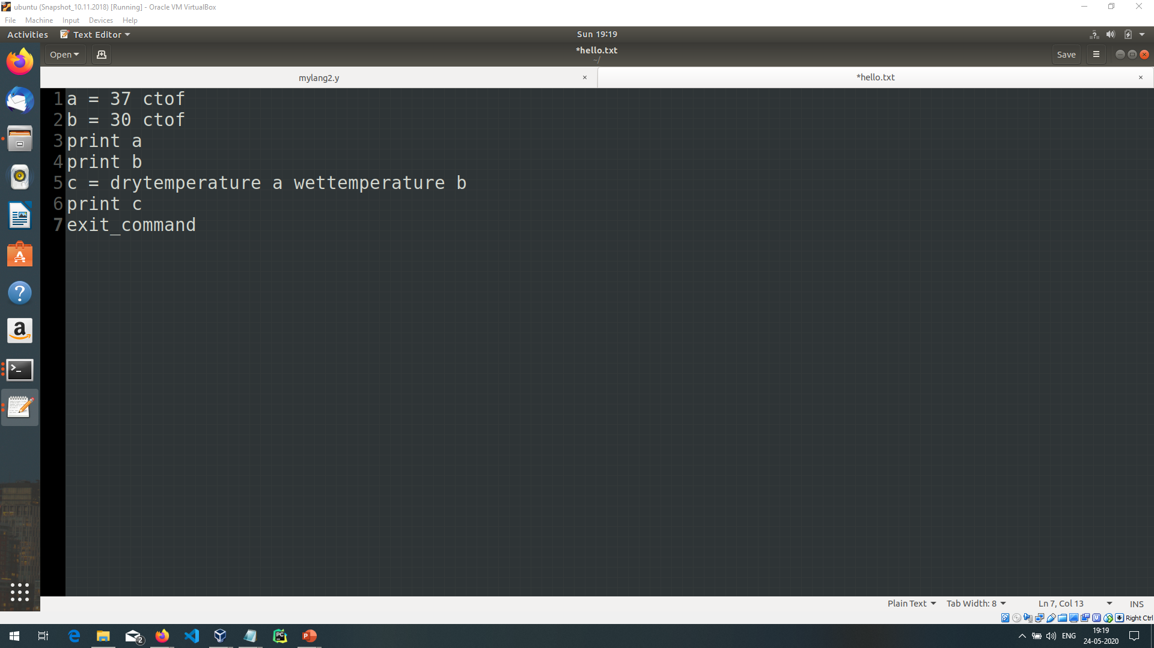
INPUTS:-
Here the series of inputs are given in order to find relative humidity . Name of the file is hello.txt.

Slide 4
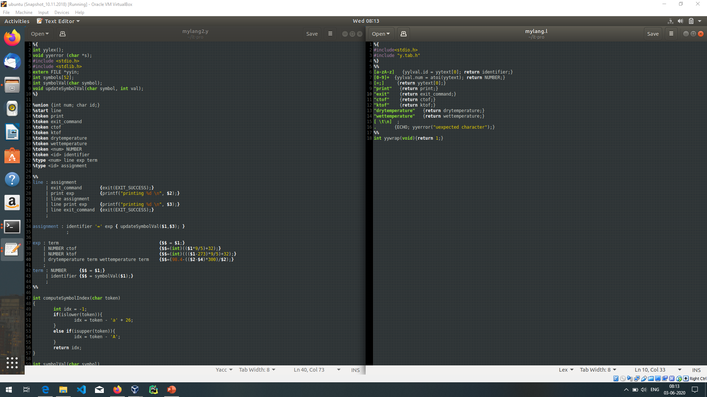
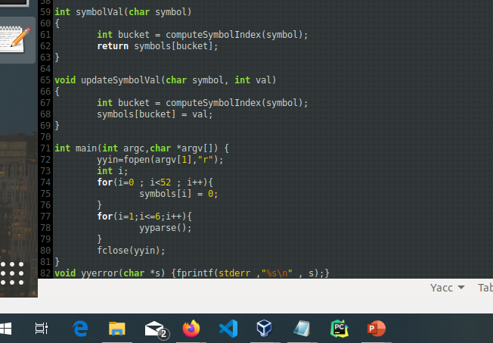

Slide 5
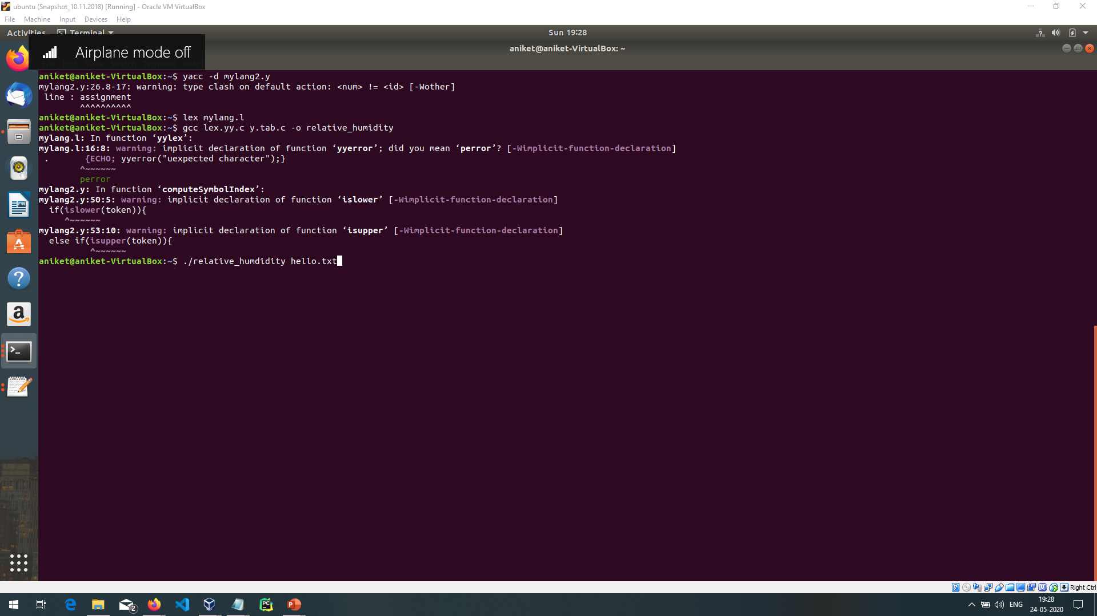

COMPILATION STEPS AND OUTPUT

